Slide 1


Digital Holographic Reconstruction
Tom Zimmerman
IBM Research-Almaden
Center for Cellular Construction
2.22.22
This material is based upon work supported by the NSF under Grant No. DBI-1548297.
Disclaimer: Any opinions, findings and conclusions or recommendations expressed in this material are those of the authors and do not necessarily reflect the views of the National Science Foundation.

Slide 2
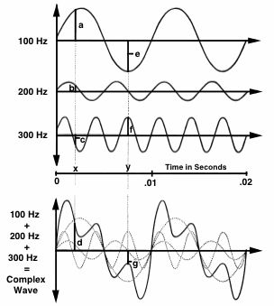
Fourier Analysis & Synthesis
Any time-varying (complex) sound can be analyzed to find its frequency components.
Any complex wave can be constructed by adding together sine waves of appropriate frequency, amplitude, and phase.
https://hearinghealthmatters.org

Slide 3
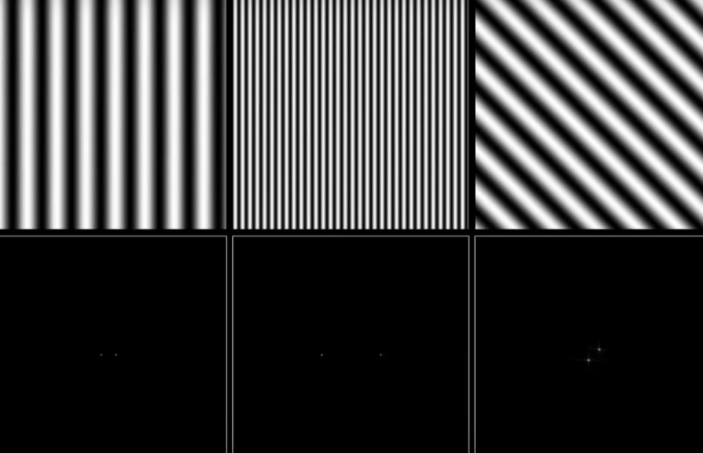
https://youtu.be/gwaYwRwY6PU

Slide 4
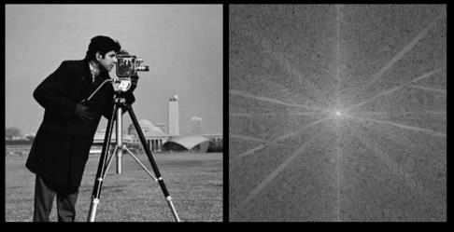

Image of “cameraman” Copyright MIT

Slide 5
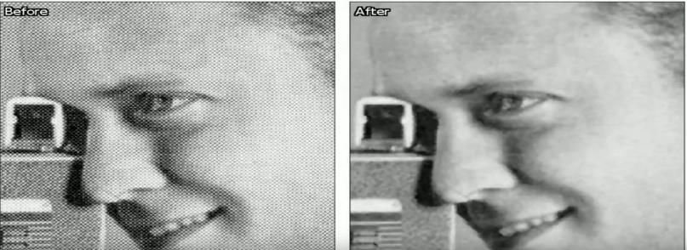
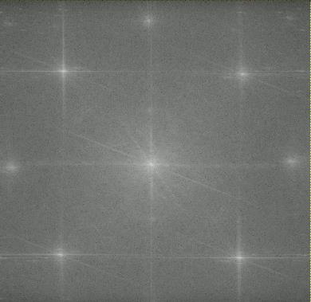
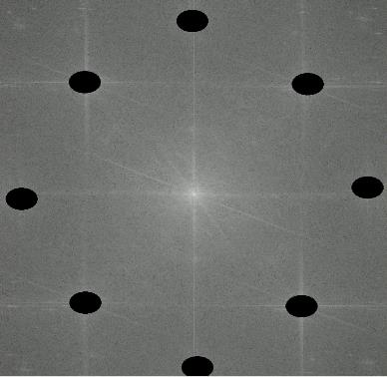
https://youtu.be/3137dDa6P4s

Slide 6
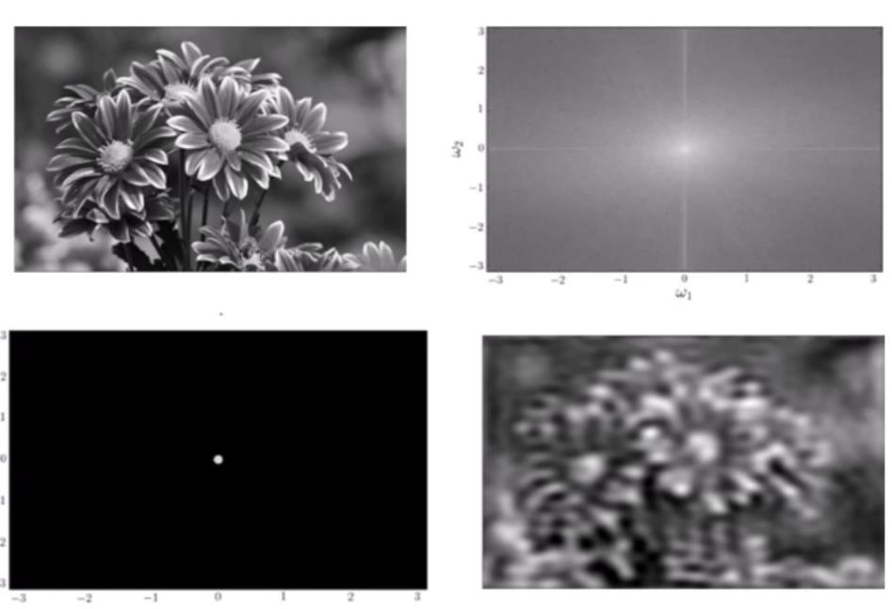
Low Pass Filter
https://youtu.be/oACegp4iGi0

Slide 7
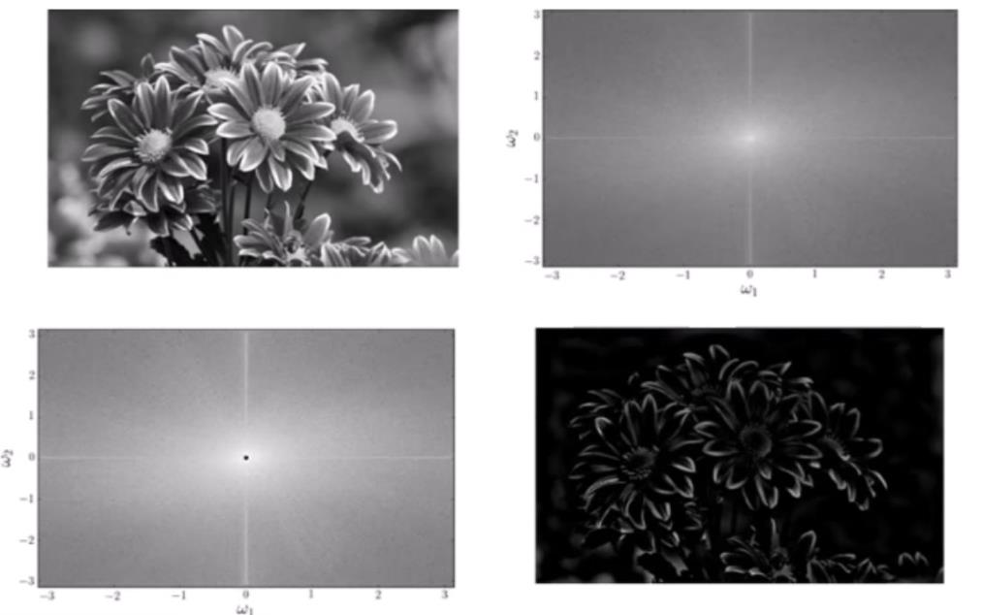
High Pass Filter
https://youtu.be/oACegp4iGi0

Slide 8
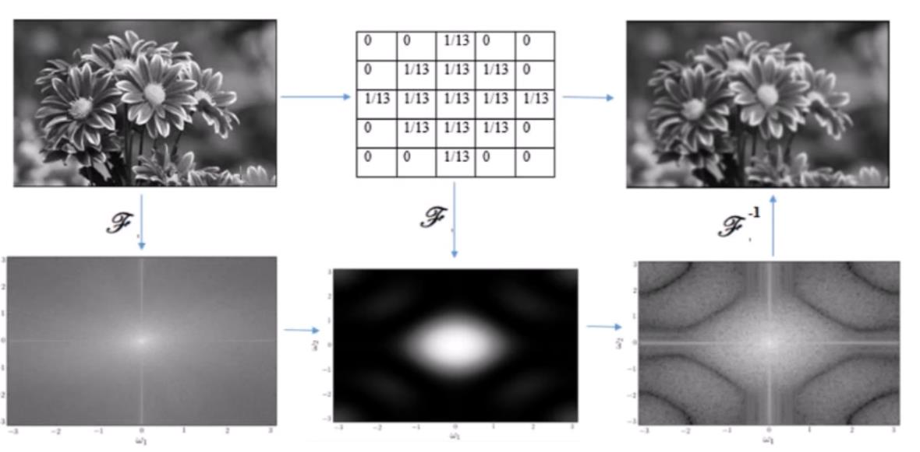
Low Pass Filtering in the Spatial and Frequency Domain
Convolution Kernel
Multiplication in the Frequency Domain = Convolution in the Time Domain

Slide 9
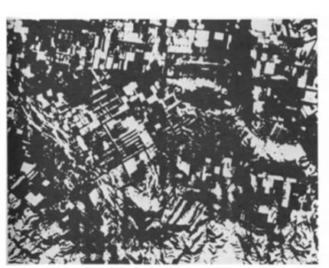
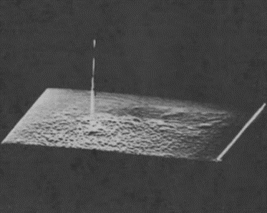
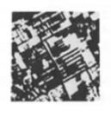
Cross-Correlation
Test Image f(x,y) Template Image h(x,y) Cross Correlation
C(i,j) = f(x,y)h(i+x,j+y)dxdy
C=F⁻¹[F{f} F{h}]
Multiplication in the Frequency Domain = Convolution in the Time Domain
Hetch, Optics
https://youtu.be/MQm6ZP1F6ms

Slide 10
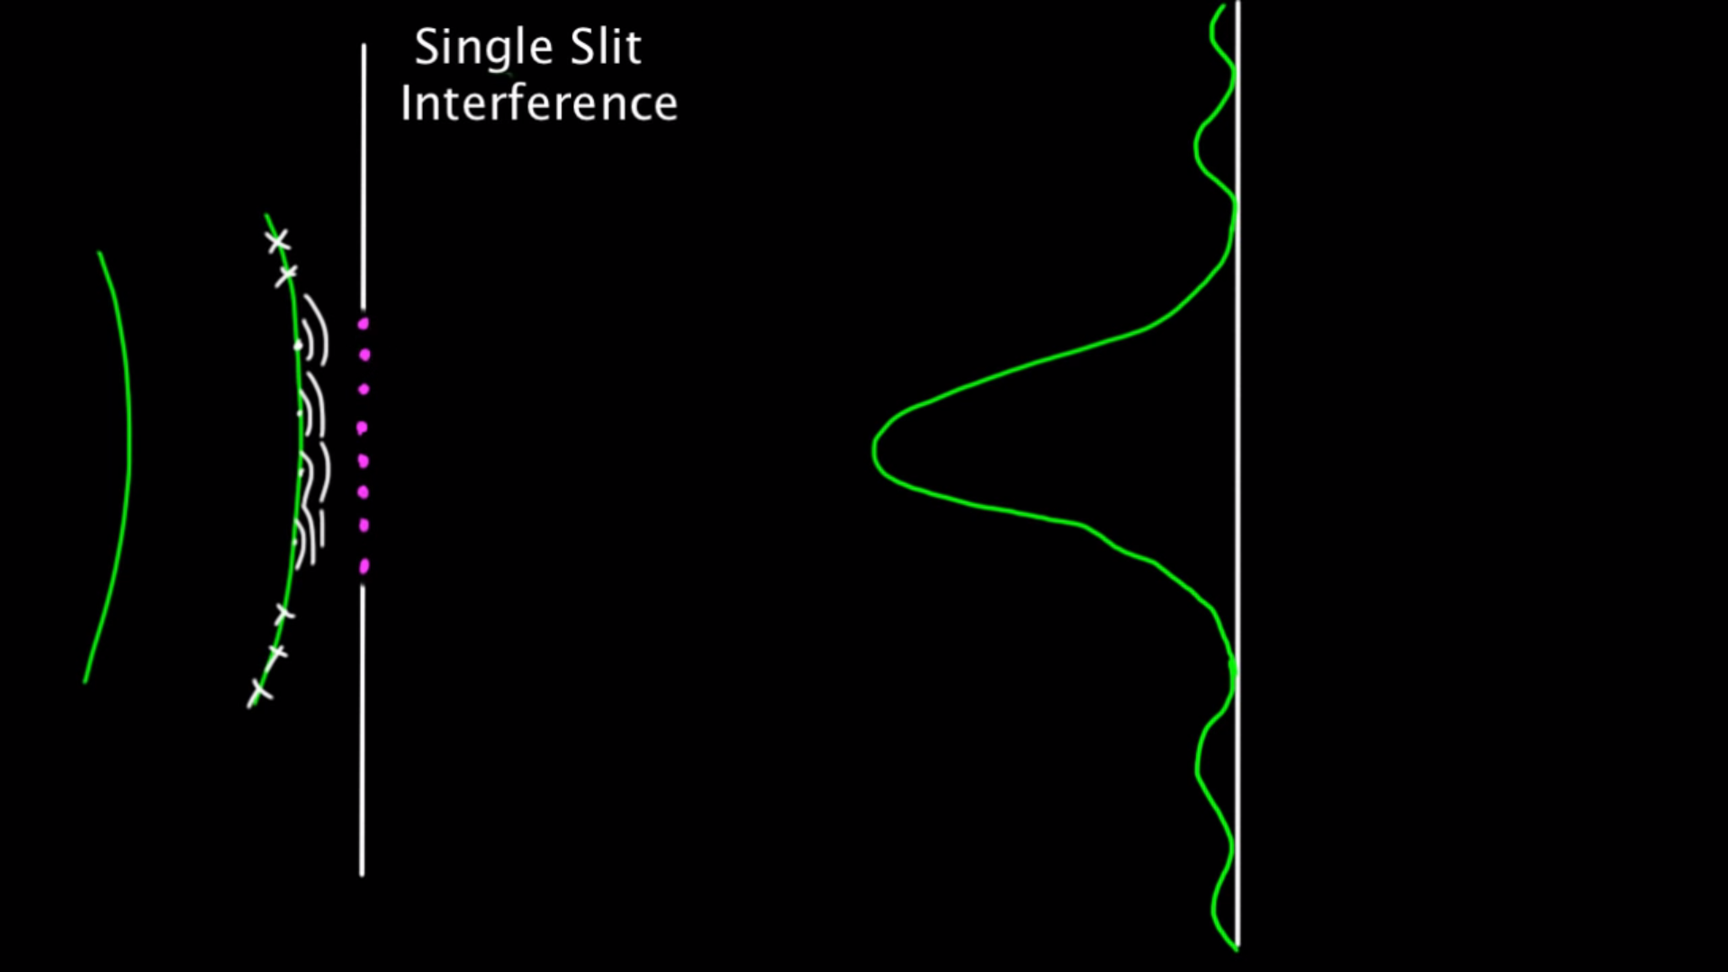
Huygens Principle (1678)
3W/D
2W/D
W/D
W
D

Slide 11
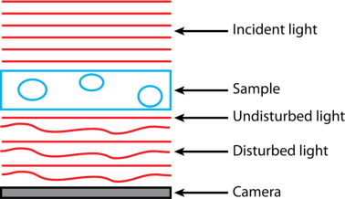
https://www.sciencedirect.com/science/article/pii/S1046202317302384

Slide 12
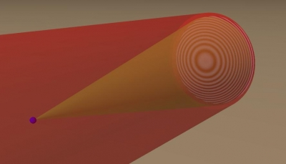
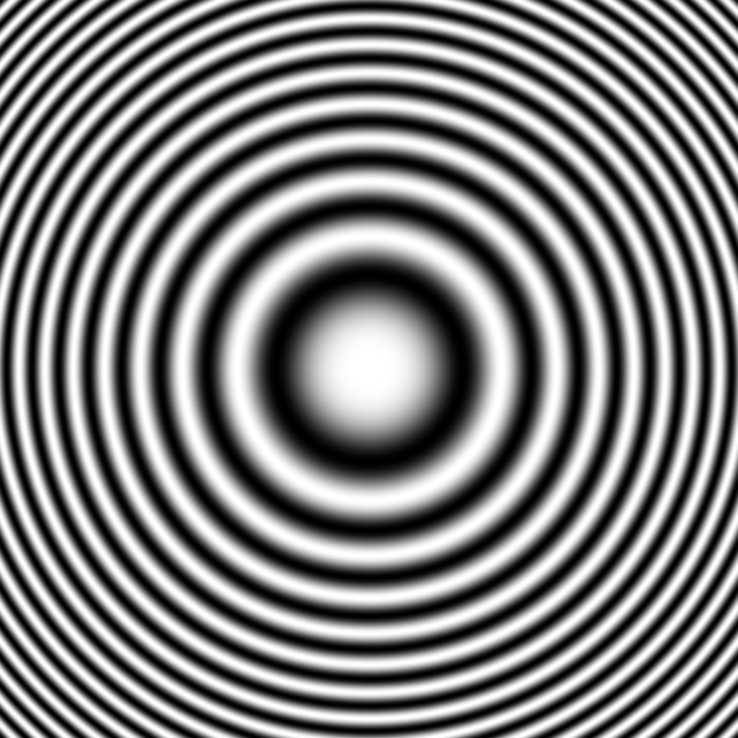
Creating Hologram of Point Object
Image Sensor
Reference Beam
Interference Pattern
LASER
Subject Beam
Subject
(point)
Z
Fresnel Zone Plate
https://github.com/manoharan-lab/holopy
Manoharan Lab, Harvard
https://holopy.readthedocs.io/en/latest/users/index.html
https://manoharan.seas.harvard.edu/holographic-microscopy

Slide 13
Reconstruction with Laser
Laser
Reconstructed
Subject
Photographic Film of Interference Pattern
(Fresnel Zone Plate for point source)

Slide 14
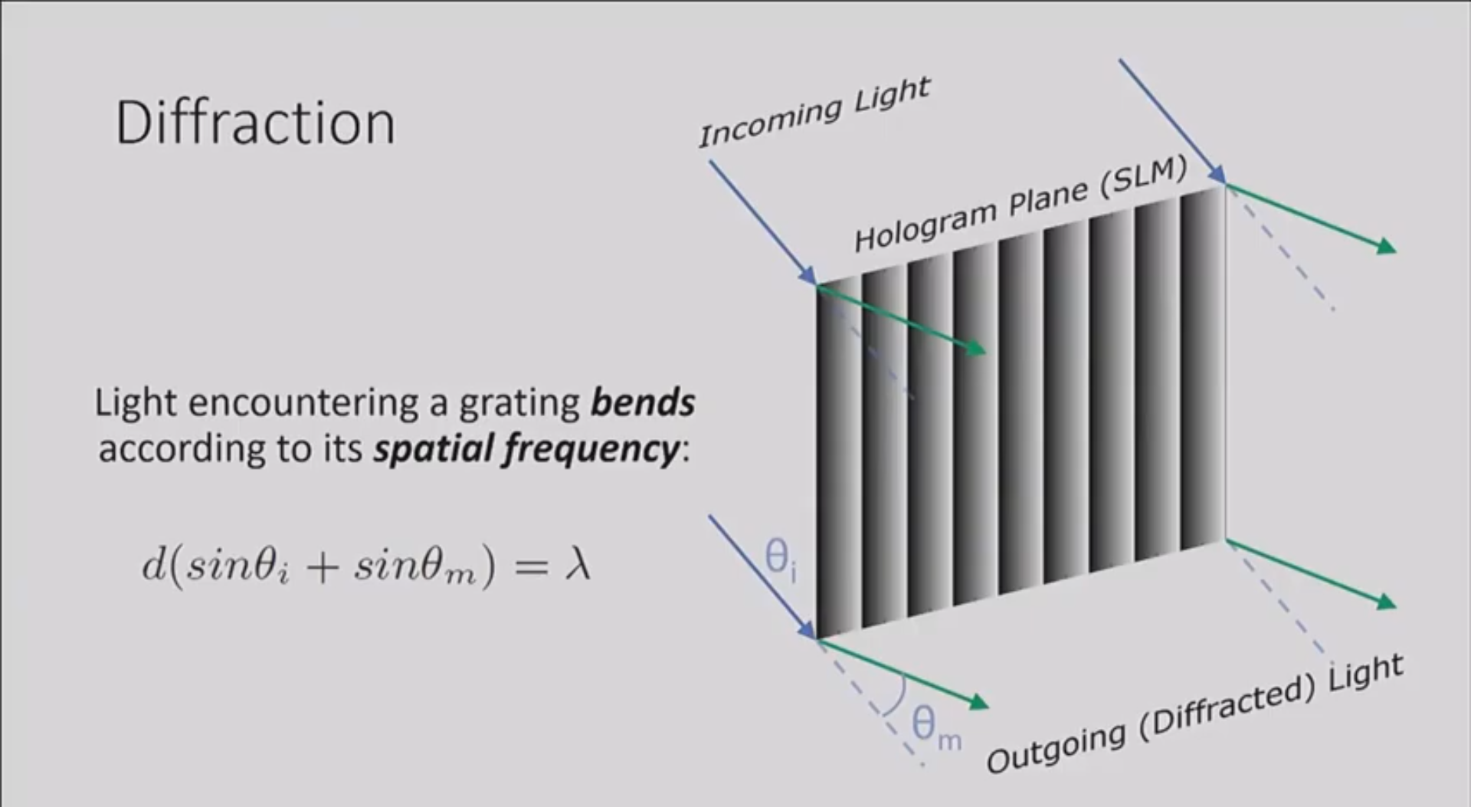
https://youtu.be/oq9UsYHyUvo

Slide 15
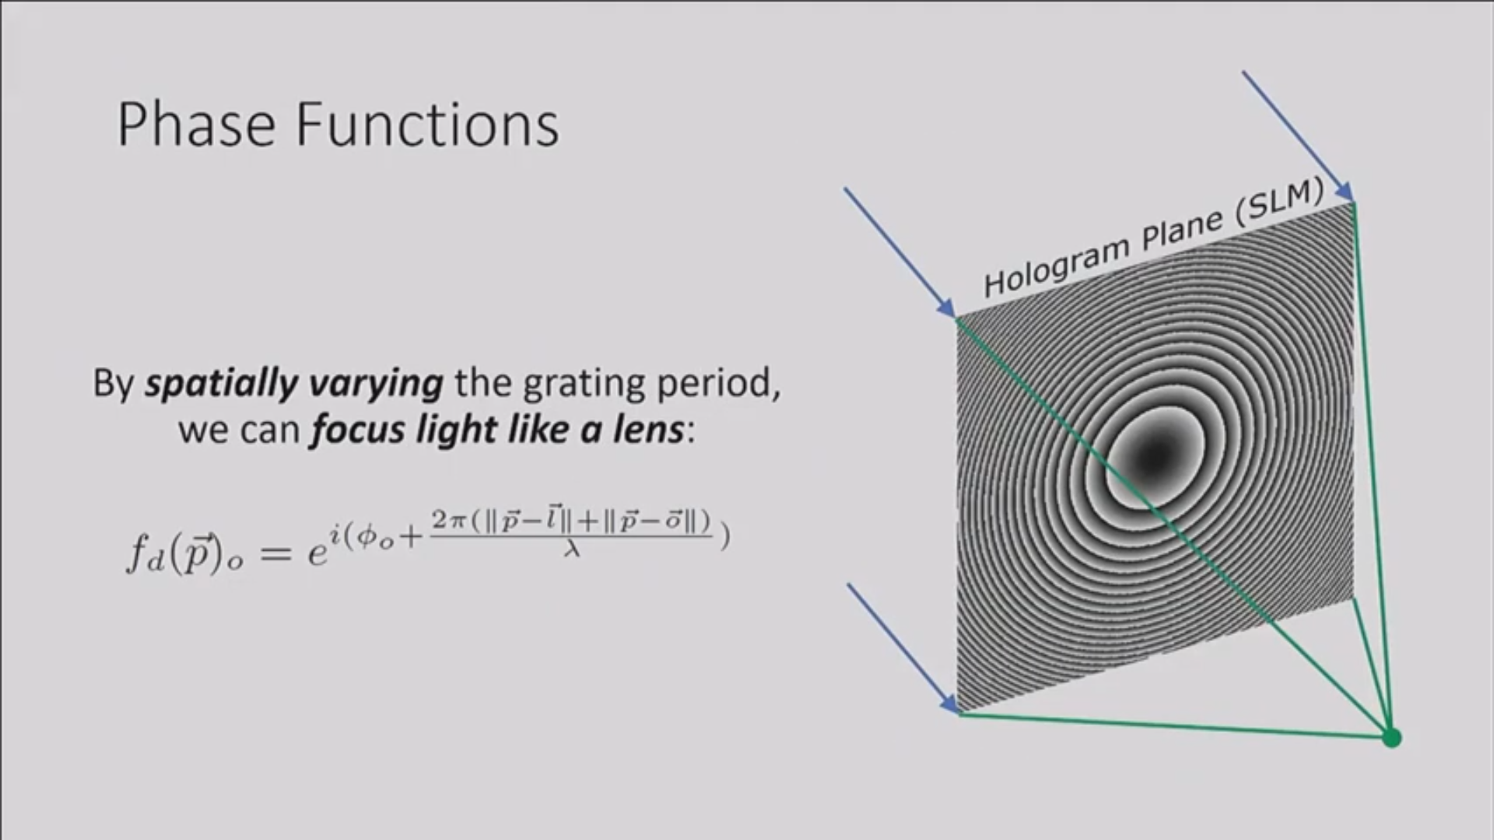
https://youtu.be/oq9UsYHyUvo

Slide 16
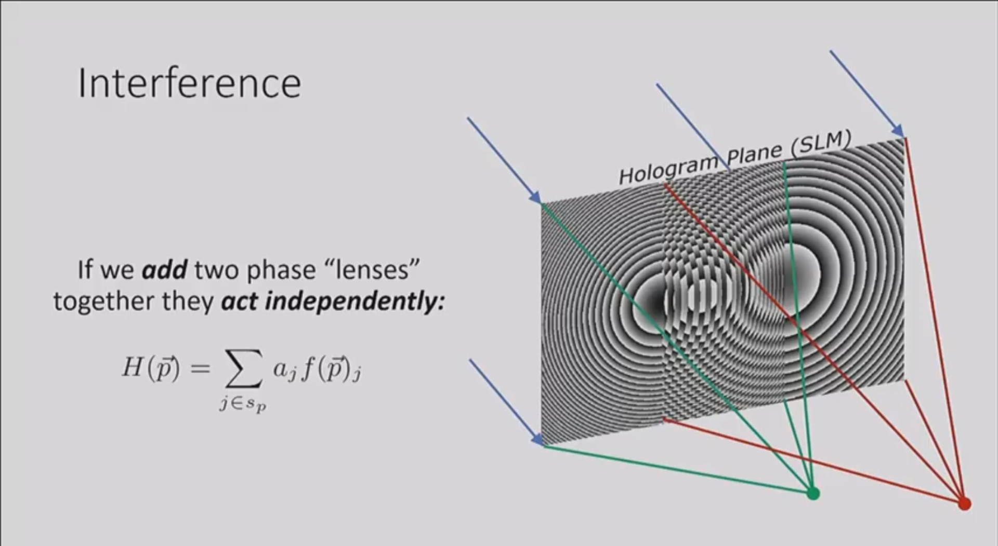
https://youtu.be/oq9UsYHyUvo

Slide 17
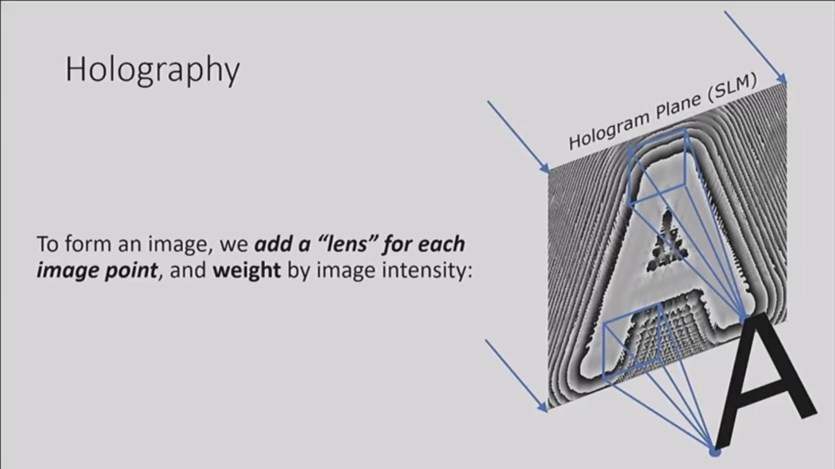
https://youtu.be/oq9UsYHyUvo

Slide 18
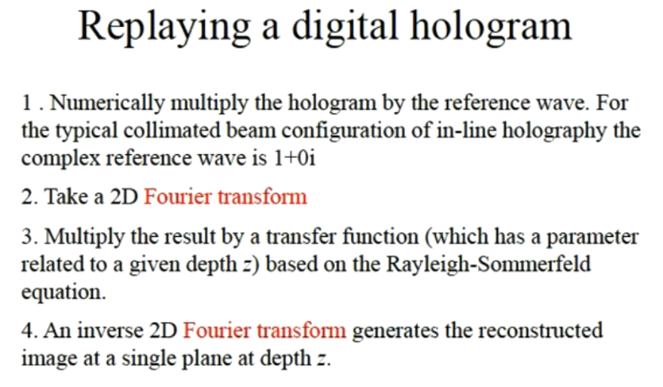
(no complex part)
# make a grid the same size of the image
M, N = input_img.shape # get image size, rows M, columns N
kx,ky = x / (dxy * N), y / (dxy * M)
kxy2 = (kx * kx) + (ky * ky)
# compute phase aberration in the grid
_ph_abbr = np.exp(-1j * np.pi * wvlen * zdist * kxy2) # Pi * wavelength * Z distance
https://youtu.be/_BzEi3PD3Y0

Slide 19
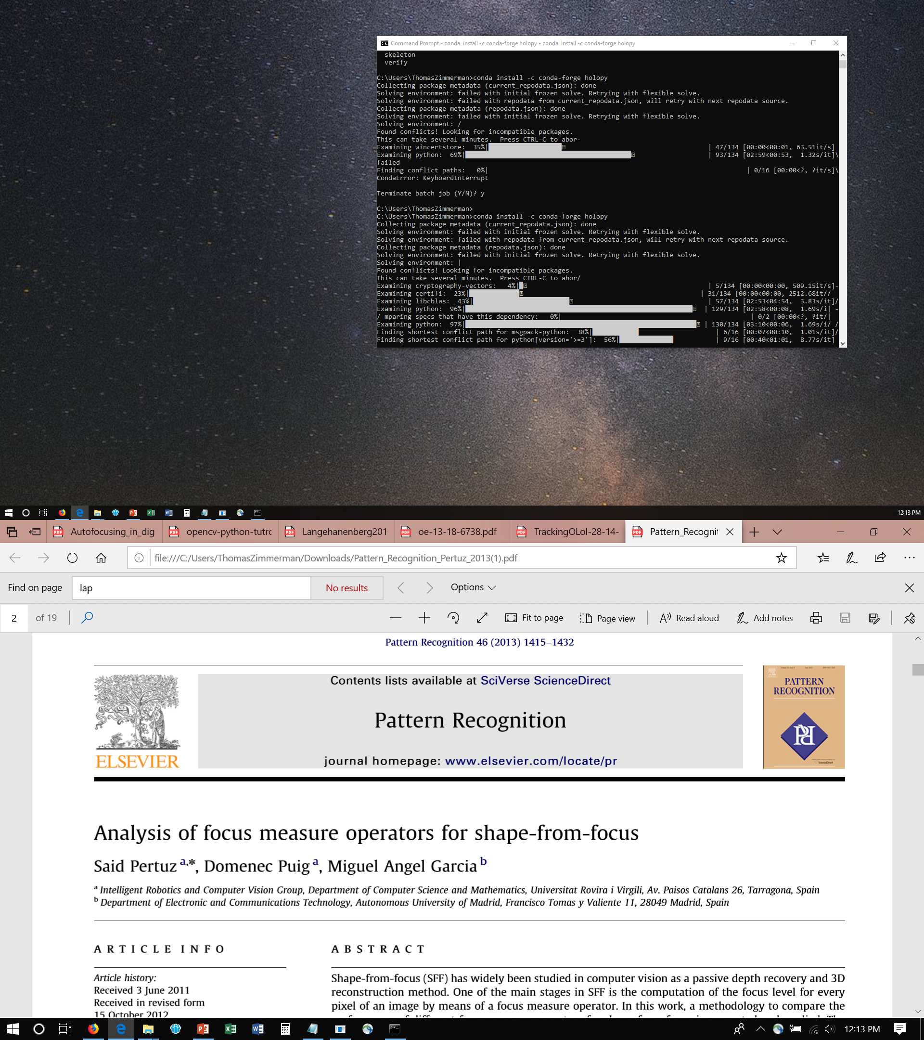
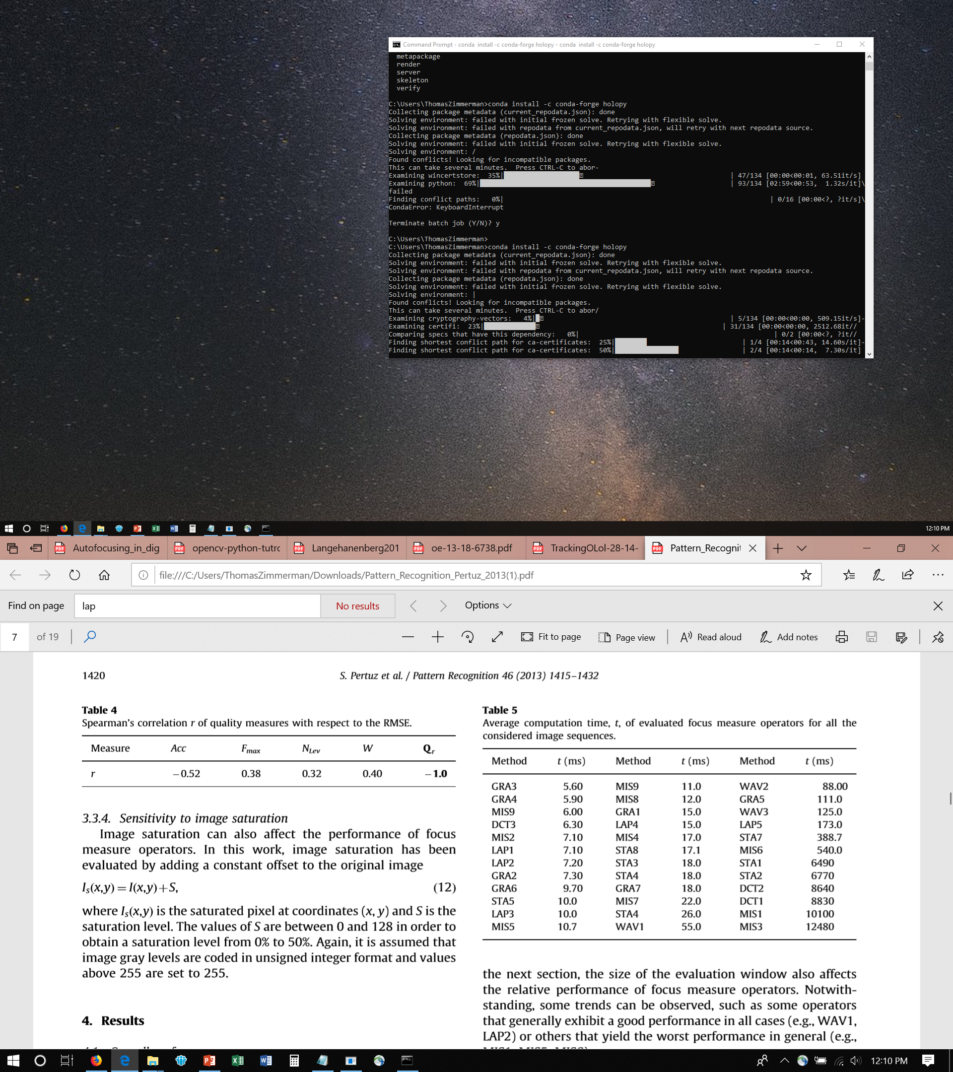
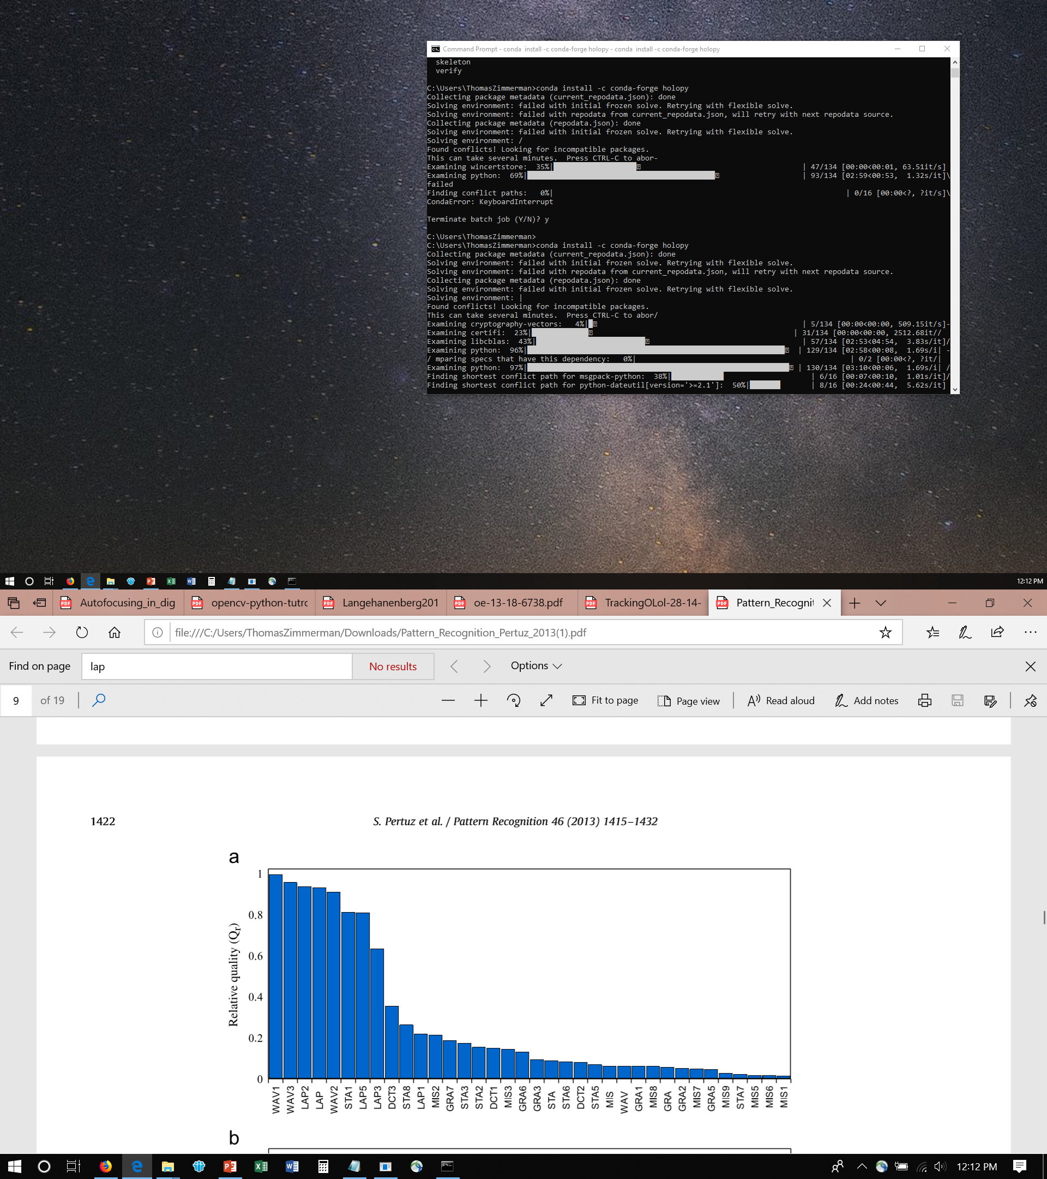

Slide 20
Autofocus Metric Algorithm
https://stackoverflow.com/questions/7765810/is-there-a-way-to-detect-if-an-image-is-blurry
// OpenCV port of 'LAPM' algorithm (Nayar89)
double modifiedLaplacian(const cv::Mat& src)
{
cv::Mat M = (Mat_<double>(3, 1) << -1, 2, -1);
cv::Mat G = cv::getGaussianKernel(3, -1, CV_64F);
cv::Mat Lx;
cv::sepFilter2D(src, Lx, CV_64F, M, G);
cv::Mat Ly;
cv::sepFilter2D(src, Ly, CV_64F, G, M);
cv::Mat FM = cv::abs(Lx) + cv::abs(Ly);
double focusMeasure = cv::mean(FM).val[0];
return focusMeasure;
}
// OpenCV port of 'TENG' algorithm (Krotkov86)
double tenengrad(const cv::Mat& src, int ksize)
{
cv::Mat Gx, Gy;
cv::Sobel(src, Gx, CV_64F, 1, 0, ksize);
cv::Sobel(src, Gy, CV_64F, 0, 1, ksize);
cv::Mat FM = Gx.mul(Gx) + Gy.mul(Gy);
double focusMeasure = cv::mean(FM).val[0];
return focusMeasure;
}
// OpenCV port of 'LAPV' algorithm (Pech2000)
double varianceOfLaplacian(const cv::Mat& src)
{
cv::Mat lap;
cv::Laplacian(src, lap, CV_64F);
cv::Scalar mu, sigma;
cv::meanStdDev(lap, mu, sigma);
double focusMeasure = sigma.val[0]*sigma.val[0];
return focusMeasure;
}
// OpenCV port of 'GLVN' algorithm (Santos97)
double normalizedGraylevelVariance(const cv::Mat& src)
{
cv::Scalar mu, sigma;
cv::meanStdDev(src, mu, sigma);
double focusMeasure = (sigma.val[0]*sigma.val[0]) / mu.val[0];
return focusMeasure;
}

Slide 21
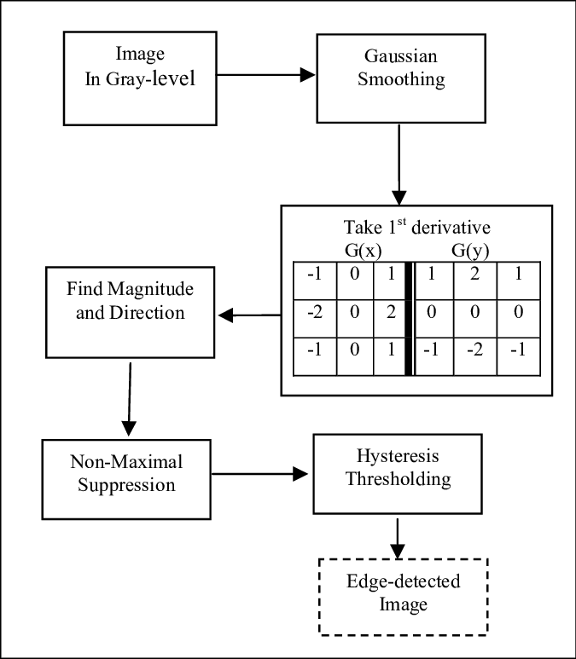
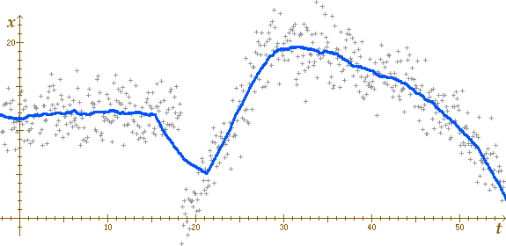
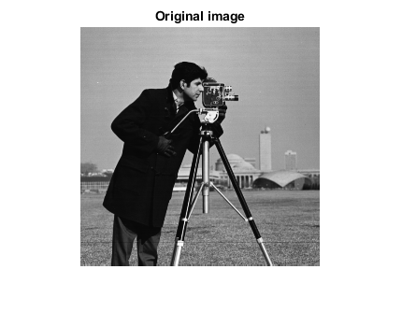

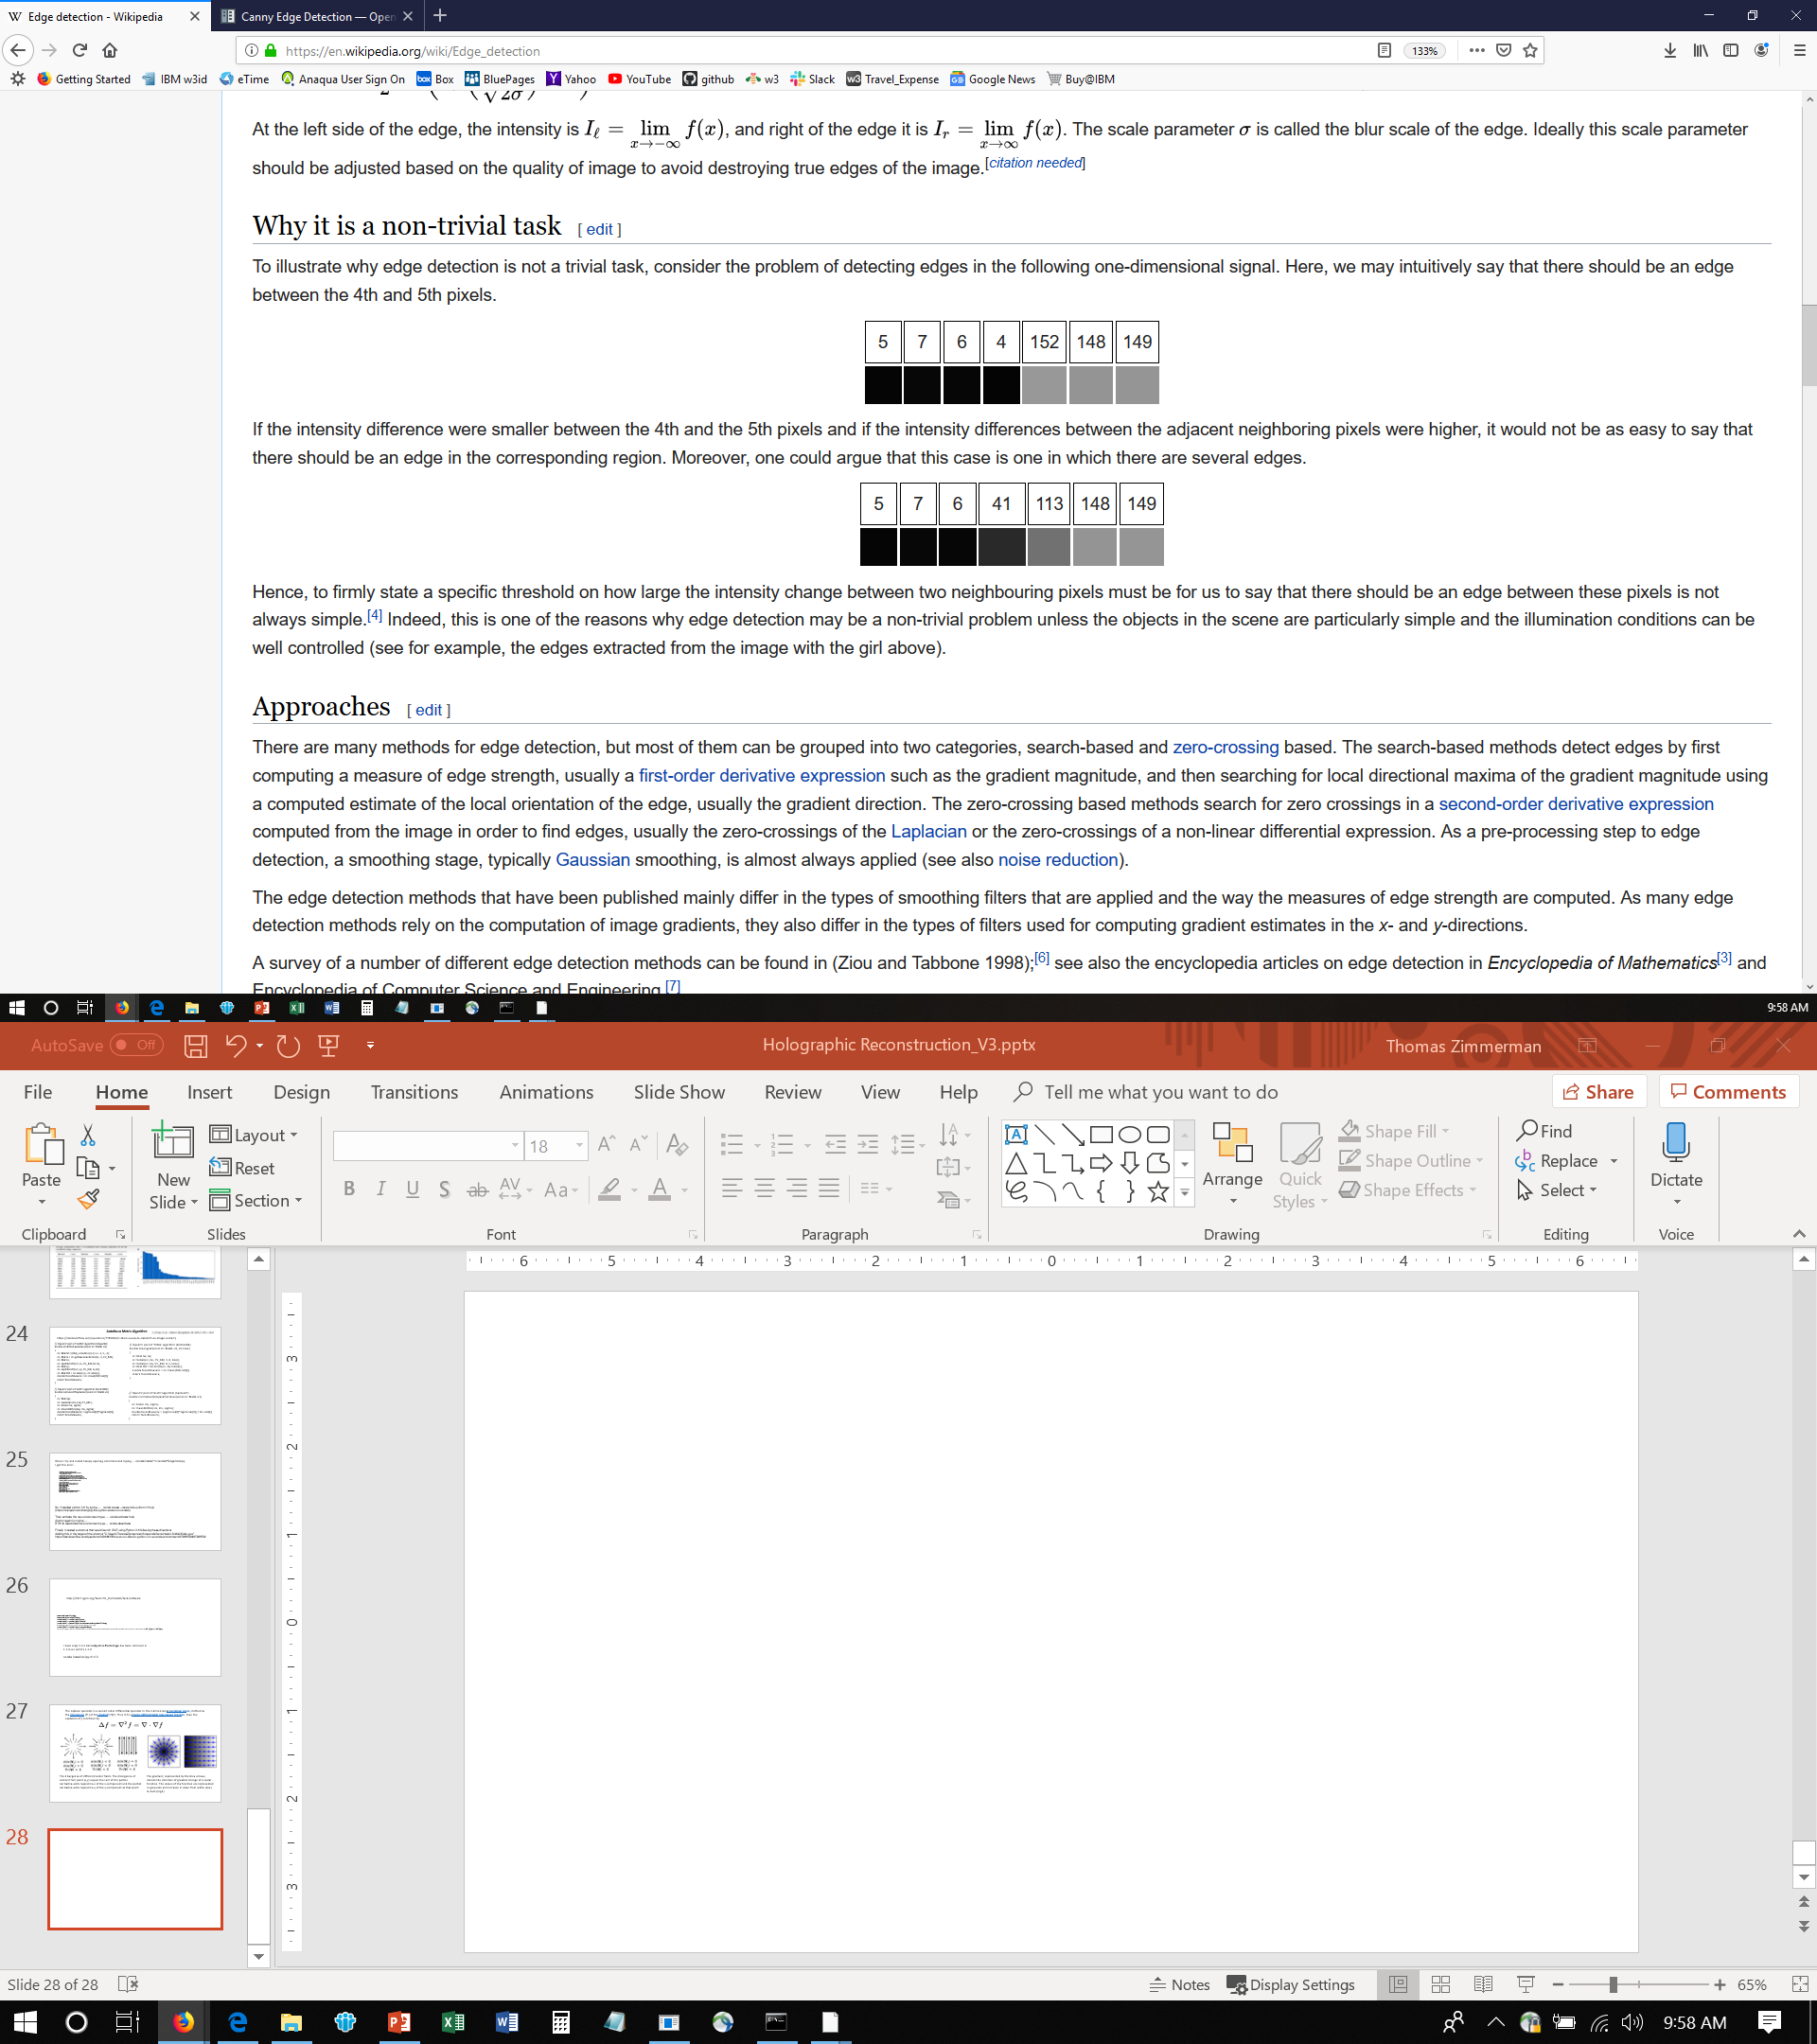
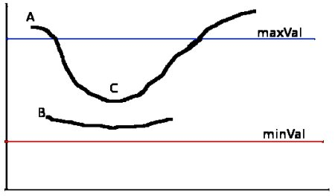
Canny Edge Detection Process
+2 -1 -2 +148 -4 +1
+2 -1 +35 +72 +35 +1
Definitely Edge
Edge only if connected to Definite Edge
Never an Edge
https://www.mathworks.com/help/images/apply-gaussian-smoothing-filters-to-images.html
An improved image processing technique for asphalt concrete X-ray CT images Jun 2013, Habtamu M. Zelelew, HM et al.

Slide 22
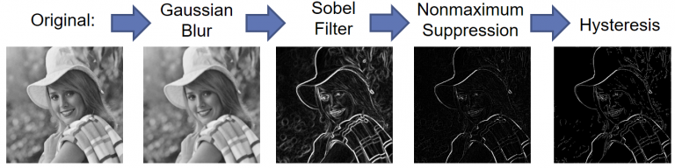
https://www.legupcomputing.com/blog/index.php/2017/08/25/canny-edge-detector-using-legup/

Slide 23
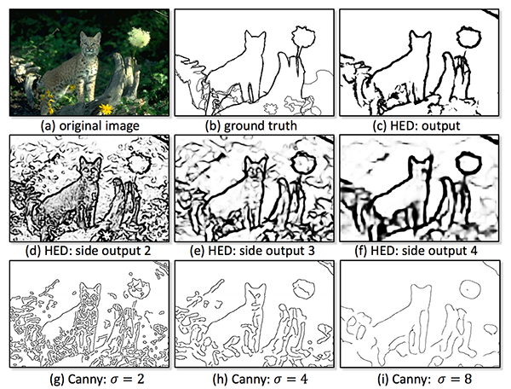
Canny Edge Detection
https://www.pyimagesearch.com/2019/03/04/holistically-nested-edge-detection-with-opencv-and-deep-learning/

Slide 24
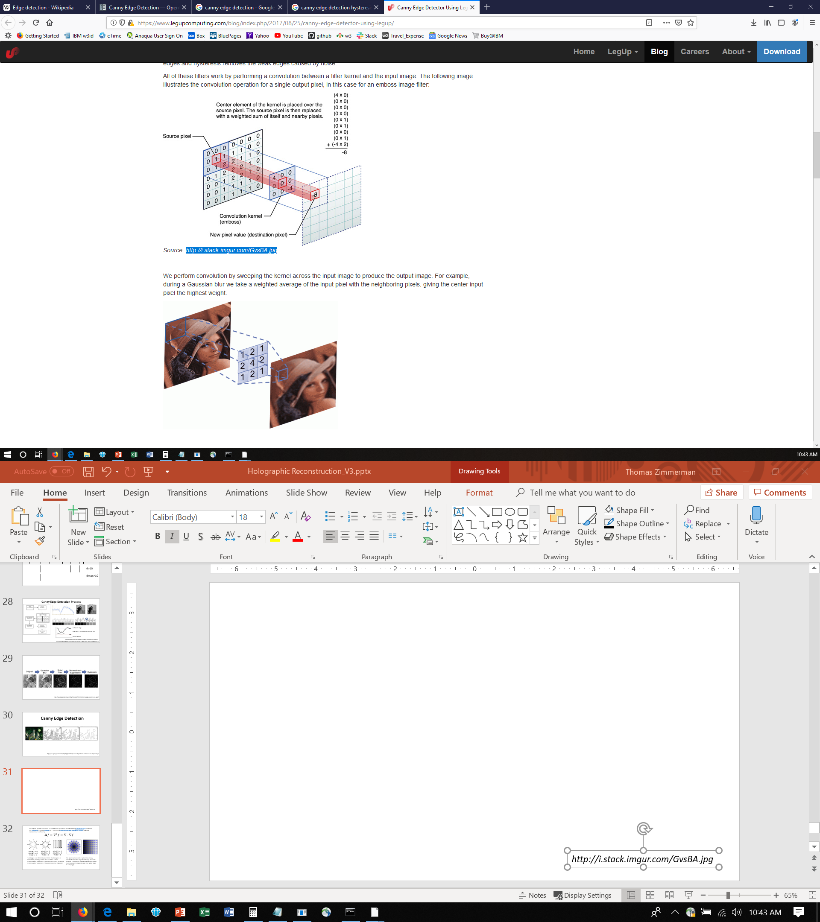
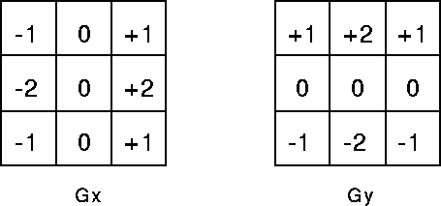
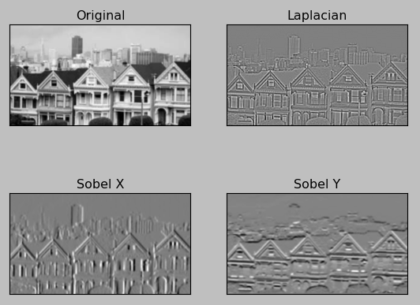
Sobel Convolution Kernels
1/16*
https://www.legupcomputing.com/blog/index.php/2017/08/25/canny-edge-detector-using-legup/
http://i.stack.imgur.com/GvsBA.jpg
Sobel Convolution Kernels https://homepages.inf.ed.ac.uk/rbf/HIPR2/sobel.htm

Slide 25
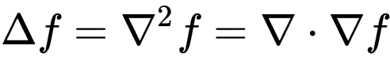
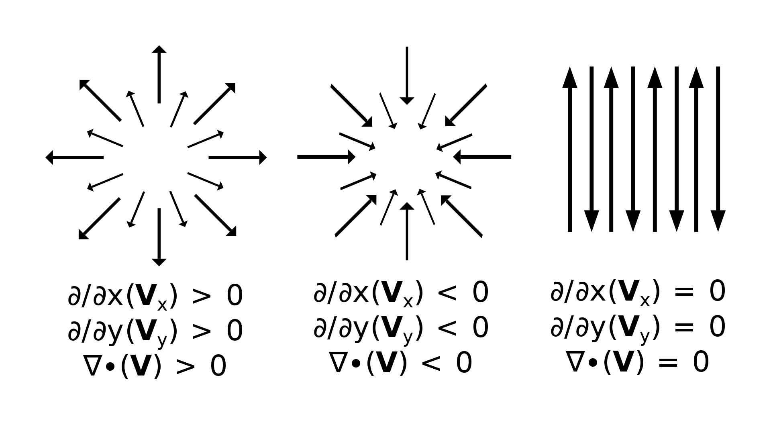
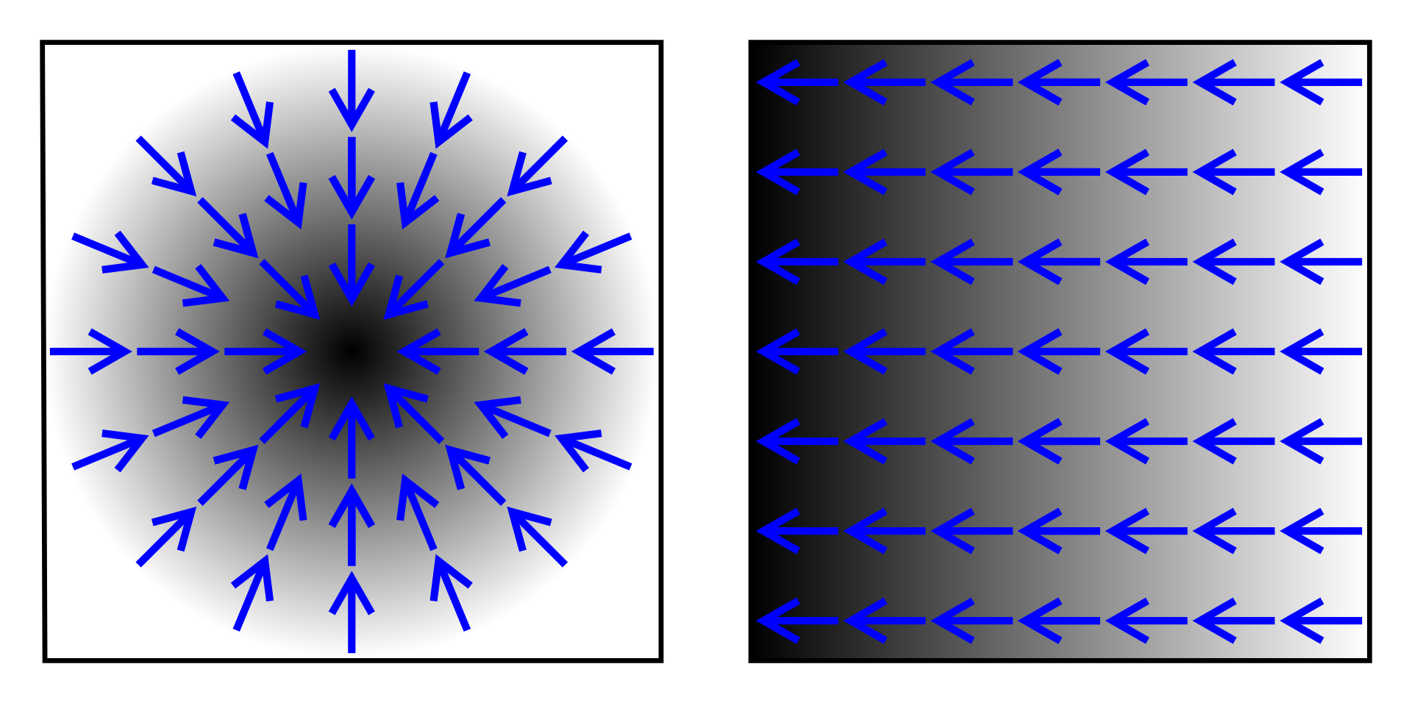
The Laplace operator is a second order differential operator in the n-dimensional Euclidean space, defined as the divergence (∇·) of the gradient (∇f ). Thus if f is a twice-differentiable real-valued function, then the Laplacian of f is defined by
The divergence of different vector fields. The divergence of vectors from point (x,y) equals the sum of the partial derivative-with-respect-to-x of the x-component and the partial derivative-with-respect-to-y of the y-component at that point:
The gradient, represented by the blue arrows, denote the direction of greatest change of a scalar function. The values of the function are represented in greyscale and increase in value from white (low) to dark (high).

Slide 26
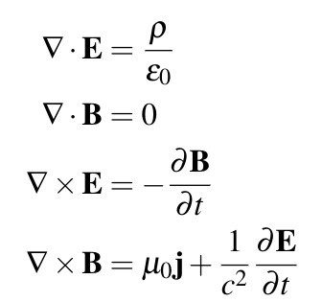
Maxwell’s Equations
Div, Grad, Curl, and All That: An Informal Text on Vector Calculus
https://www.youtube.com/watch?v=vvzTEbp9lrc

